Slide 1


CRM PIPELINE OVERVIEW
Digital Platform Delivery
Banking Cost Estimation
July 22, 2016
August 18th, 2016

Slide 2
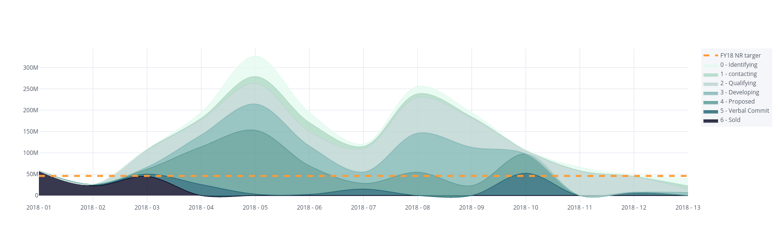
FY18 Technology - Pipeline Overview
Consulting > Technology - ALL Deals
 | New Opportunities |  |  |  | Won Opportunities |  |  |  | Lost Opportunities |  |  |  | Abandoned Opportunities
 | Since last Period |  | YTD |  | Since last Period |  | YTD |  | Since last Period |  | YTD |  | Since last Period
Service Line | Total Value | # Oppty | Total Value | # Oppty | Total Value | # Oppty | Total Value | # Oppty | Total Value | # Oppty | Total Value | # Oppty | Total Value
Oracle | 29461527 | 15 | 66613102 | 93 | 18646684 | 12 | 25894332 | 37 | 0 | 0 | 2167191 | 2 | 2407754 | 5 | 29345355 | 35
SAP | 2520688 | 9 | 63001086 | 29 | 357406 | 1 | 17681832 | 7 | 1000000 | 1 | 2255947 | 3 | 19544790 | 8 | 41690468 | 26
TS&A | 18472542 | 58 | 200435943 | 183 | 11343442 | 21 | 26723686 | 76 | 3230288 | 4 | 6409366 | 8 | 11165611 | 25 | 61905441 | 152
DC | 6480231 | 24 | 23153212 | 100 | 4564950 | 13 | 23570874 | 35 | 389132 | 5 | 3673566 | 16 | 13421048 | 20 | 38317284 | 64
AMS | 20921195 | 16 | 23042470 | 35 | 4348844 | 3 | 4703874 | 6 | 0 | 0 | 340293 | 2 | 26470558 | 8 | 37724041 | 27
DI | 8087420 | 27 | 62874973 | 84 | 2322995 | 8 | 11727399 | 30 | 142498 | 2 | 753334 | 6 | 16499577 | 17 | 28926633 | 60
AIM | 5711749 | 20 | 38838742 | 107 | 3157876 | 14 | 15795194 | 50 | 168863 | 2 | 706227 | 4 | 4336044 | 15 | 19235081 | 52
now
* Based on Total Estimated Revenue

Slide 3
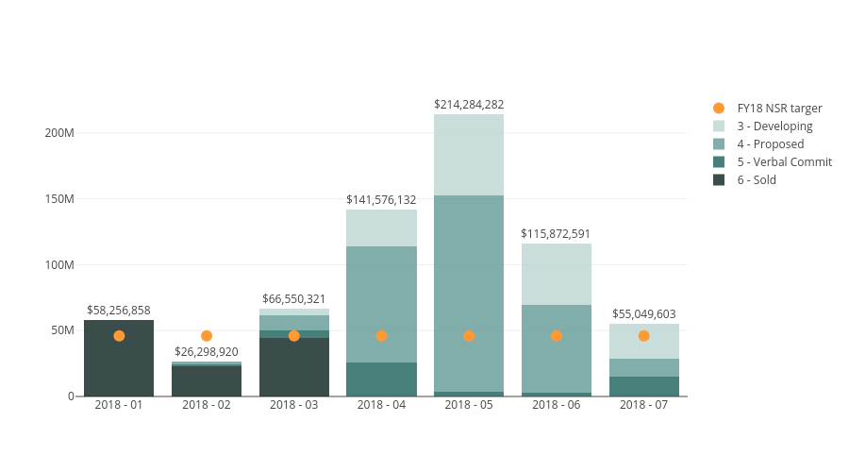
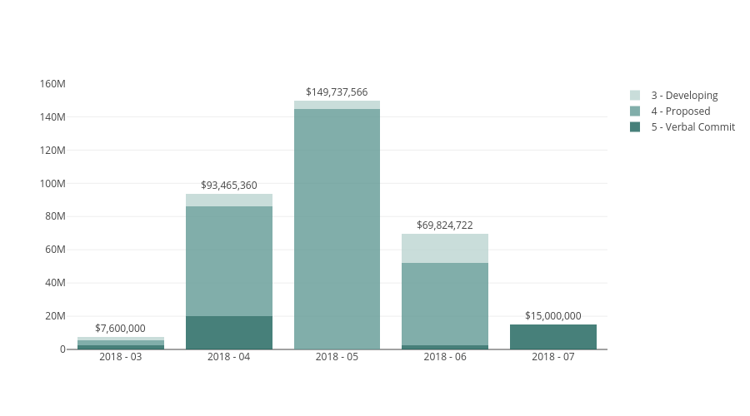
FY18 Technology - Pipeline Overview
Consulting > Technology - 90 day outlook
Consulting > Technology – ALL Deals
90 day view to focus our attention where immediate action / investment should be explored
Deals in Sales Stage Developing through to Verbal Commit will be indicators of anticipated revenue
Key deals may require additional leadership attention:
Potential immediate revenue
Beachhead with line of sight to key deal
Strategic client / opportunity
Alignment to strategy priority
Others?
Consulting > Technology – Key Deals

Slide 4
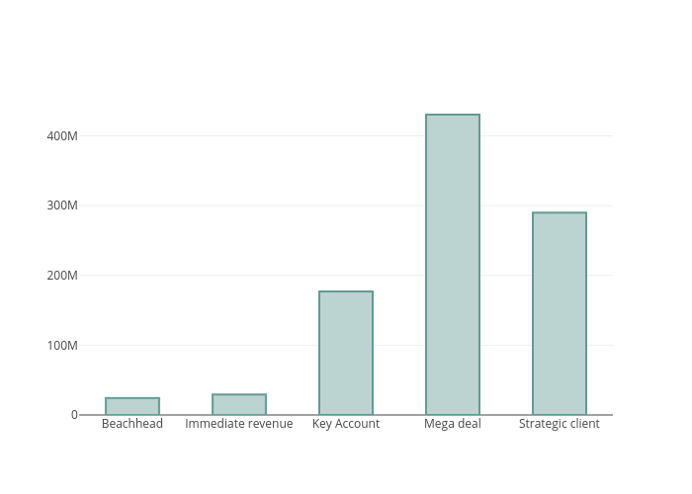
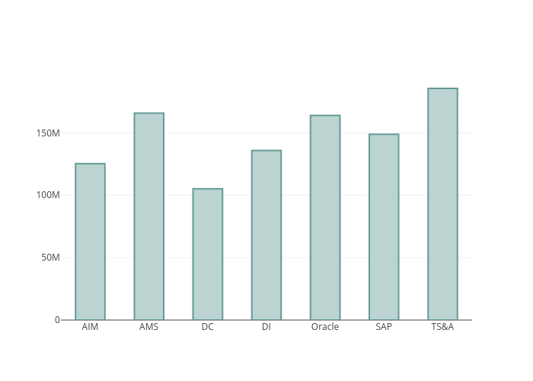
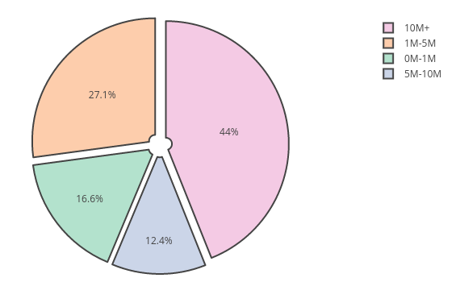
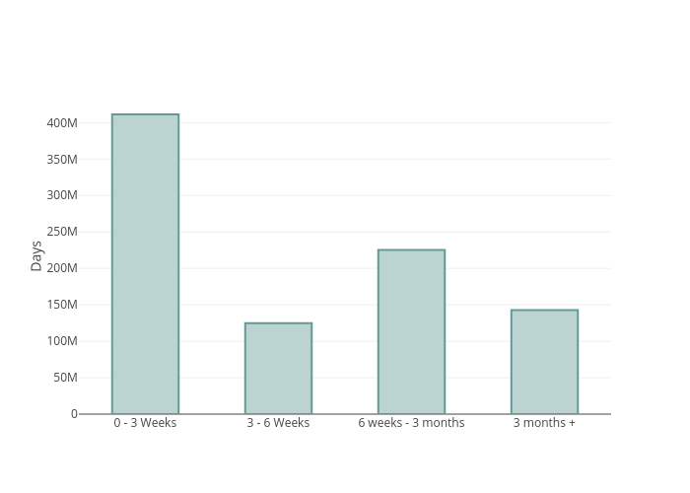
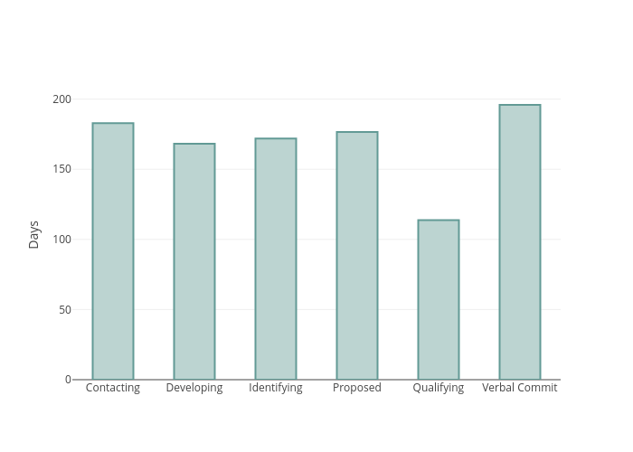
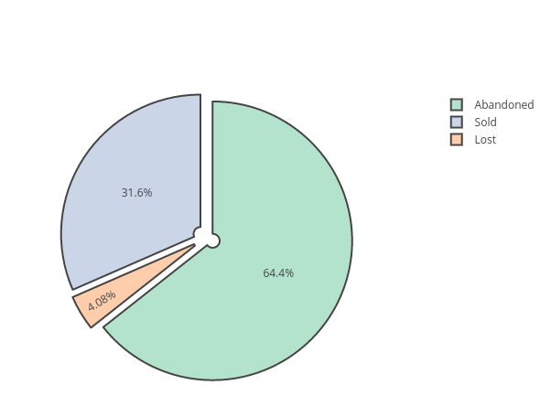
FY18 Technology - Pipeline Overview
Consulting > Technology - 90 days at a glance
service line
Deal size (count)
‘key deal’ type
Average AGE (days)
DEAL CLOSING REASON
Last Updated

